Slide 1

React.JS – Complex Components Advantages of using Component
Major advantage of using Components is Reusability
Beyond that another major advantage is Composability
You can combine components to create more complex components.

Slide 2
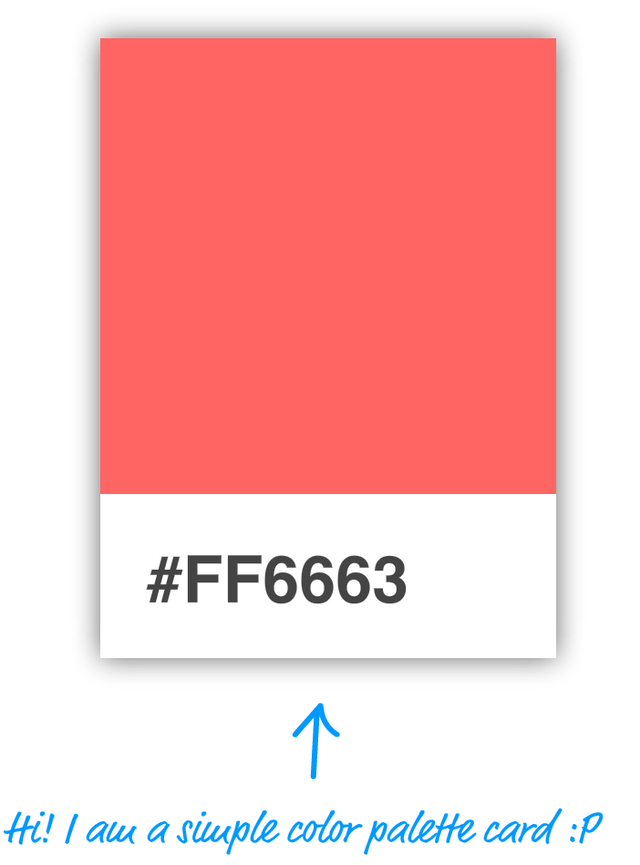
React.JS – Complex Components Composite Component
Identify the visual elements
Break them into individual components
Example:
Build a simple color palette card:

Slide 3

React.JS – Complex Components Composite Component…(cntd.)
This approach of building a card involves two steps:
Identify the major visual elements
Figure out what the components will be

Slide 4
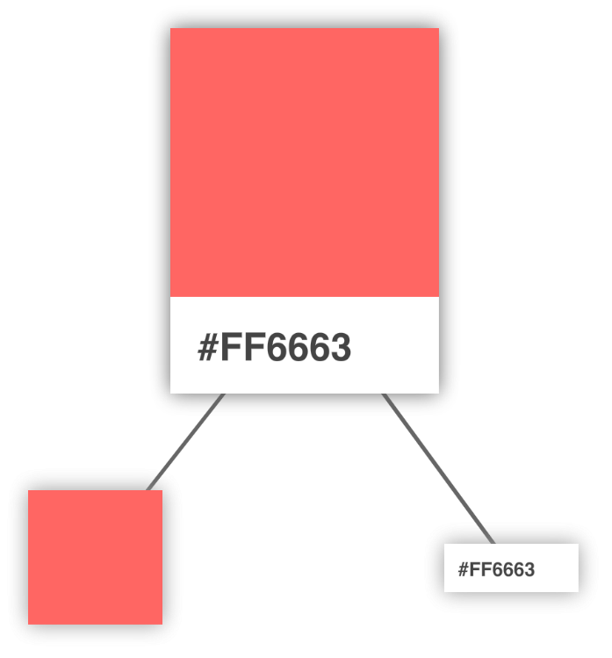
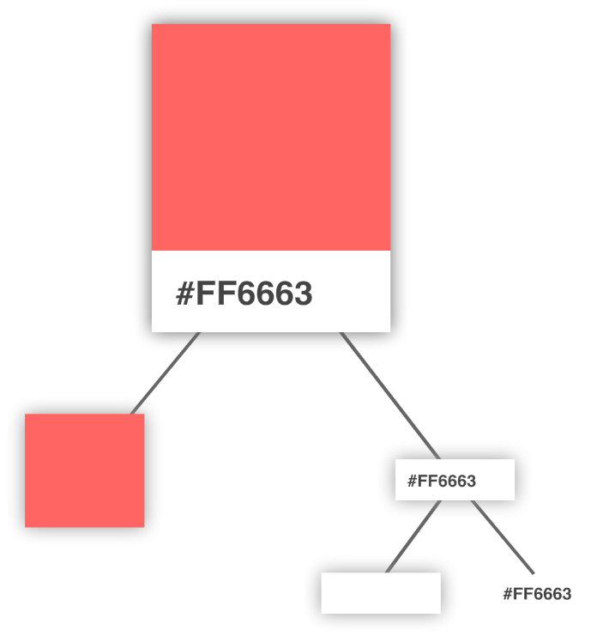
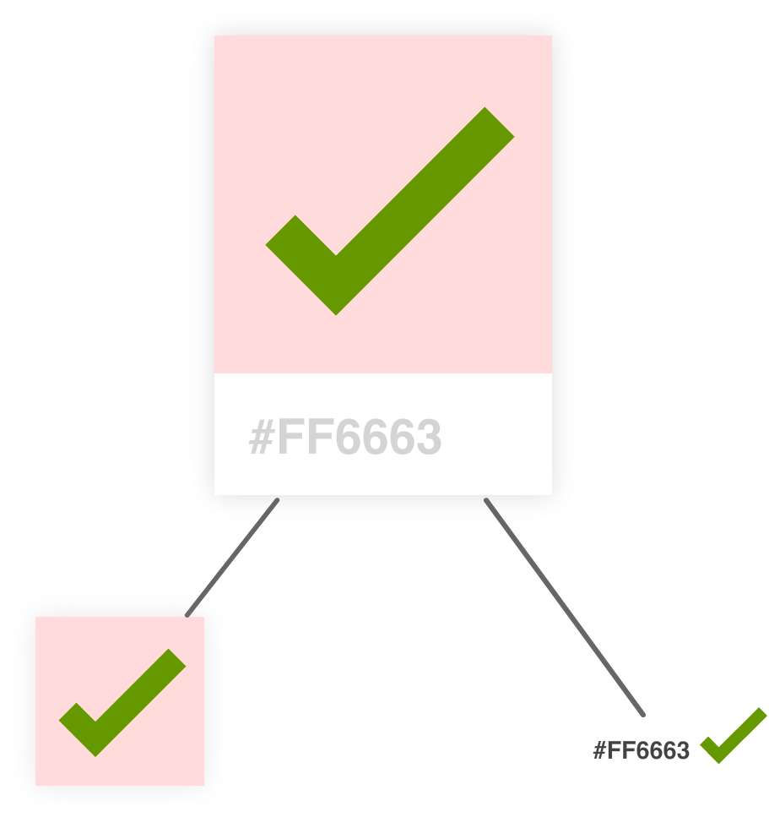
React.JS – Complex Components Composite Component…(cntd.)
Arranging your visuals into this tree-like structure (aka a visual hierarchy) is a good way to get a better feel for how your visual elements are grouped. The goal of this exercise is to identify the important visual elements and break them into a parent/child arrangement until you can divide them no further.

Slide 5
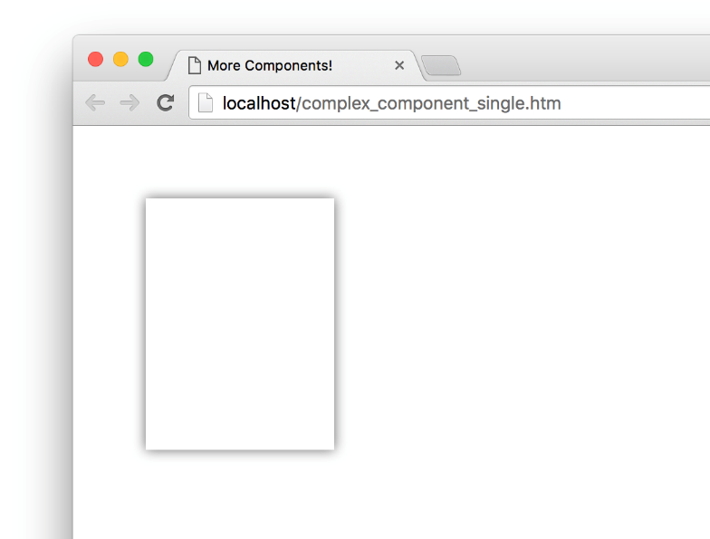
React.JS – Complex Components Composite Component…(cntd.)
The Card Component
class Card extends React.Component {
render() {
var cardStyle = {
height: 200,
width: 150,
padding: 0,
backgroundColor: "#FFF",
filter: "drop-shadow(0px 0px 5px #666)"
};
return (
<div style={cardStyle}>
</div>
);
}
}
ReactDOM.render( <div>
<Card/>
</div>,
document.querySelector("#container")
);

Slide 6
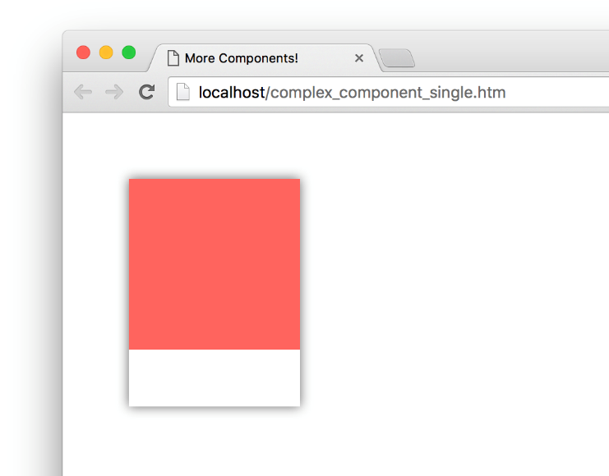
React.JS – Complex Components Composite Component…(cntd.)
The Square Component
class Card extends React.Component {
render() {
var cardStyle = {
height: 200,
width: 150,
padding: 0,
backgroundColor: "#FFF",
filter: "drop-shadow(0px 0px 5px #666)"
};
return (
<div style={cardStyle}>
<Square />
</div>
);
}
}
class Square extends React.Component {
render() {
var squareStyle = {
height: 150,
backgroundColor: "#FF6663"
};
return (
<div style={squareStyle}>
</div>
);
}
}

Slide 7
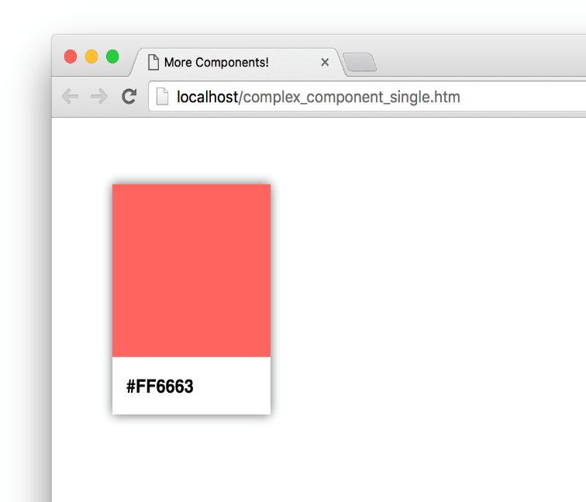
React.JS – Complex Components Composite Component…(cntd.)
The Label Component
class Card extends React.Component {
render() {
var cardStyle = {
height: 200,
width: 150,
padding: 0,
backgroundColor: "#FFF",
filter: "drop-shadow(0px 0px 5px #666)"
};
return (
<div style={cardStyle}>
<Square />
<Label />
</div>
);
}
}
class Label extends React.Component {
render() {
var labelStyle = {
fontFamily: "sans-serif",
fontWeight: "bold",
padding: 13,
margin: 0
};
return (
<p style={labelStyle}>#FF6663</p>
);
}}

Slide 8
React.JS – Complex Components Composite Component…(cntd.)
In our current example, we hard-coded the color value that is used by our Square and Label components. That is an odd thing to do...which may or may not have been done deliberately for dramatic effect, but fixing it is straightforward. It just involves us specifying a property name and accessing it via this.props.

Slide 9
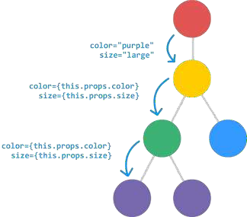
React.JS – Complex Components Transferring Properties
In the earlier example, transferring properties was not tedious as there was only one level of heirarchy
If there are multiple levels of components, transferring properties
will be very cumbersome
To overcome that, we use the spread operator (…) as follows
<Display {...this.props}/>

